Slide 1
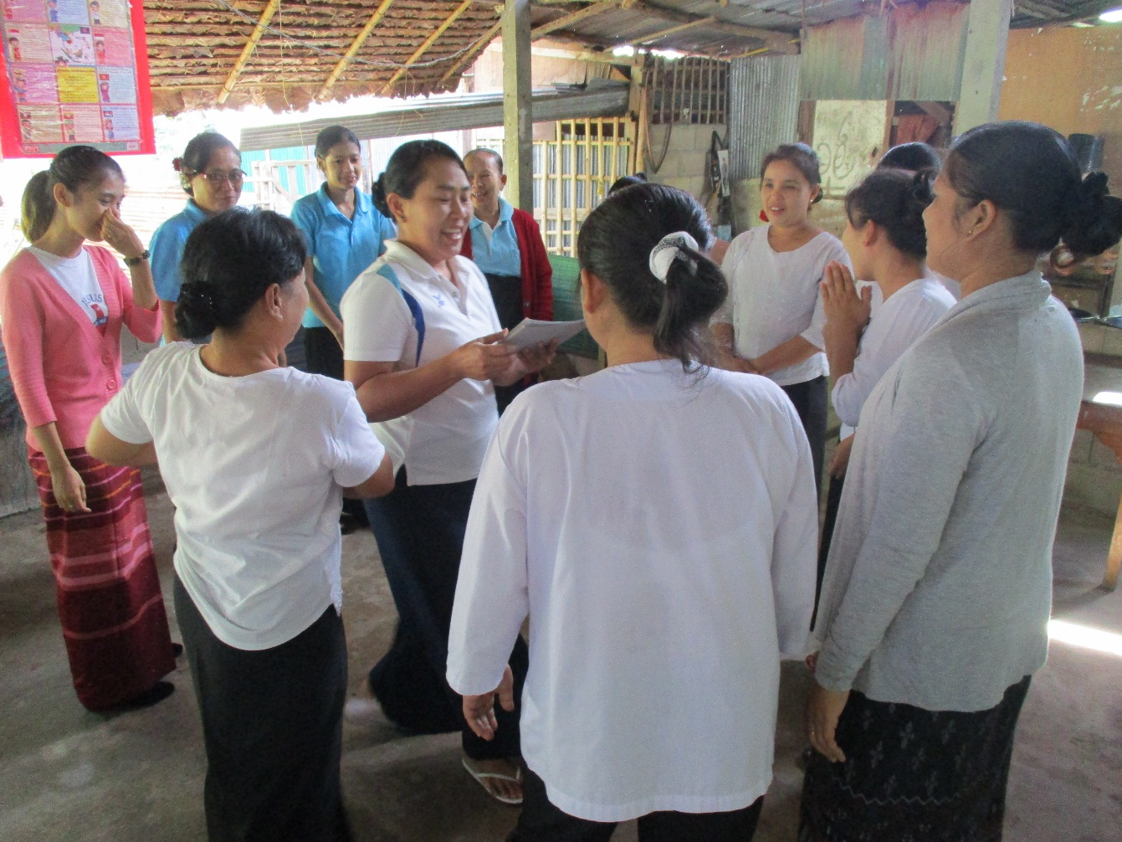
Hle Bee Primary School
Background Information
Hle Bee school was established in 1999 and now it is managed by Mrs. Thzin Soe Naing who is a Mon lady. There are 235 students and 10 teachers at the school. The school starts from KG to Grade 5. All of the teachers are from Myanmar. The school is a member of Burmese Migrant Worker Education Committee (BMWEC). Most of the teachers (old and new teachers) at Hle Bee attended our workshops in academic year 2017-2018. They are all really well organized and active in the workshops.
Teachers play circle game happily at using flashcard workshop

Slide 2
Naw Rosy Kyaw
Background Information
She is a Karen who is a new teacher and she teaches Science and English in Grade-III. She is 25 years old, has one daughter and lives with her family. She has been living in Thailand since 2007. Teaching is her hobby. She has no teacher training, but had attend youth training (TOT) for one week last year.
She finished Grade-12 at Has Thoo Lei Orphanage learning centre. Previously, she worked at Burma Act as a member for two years.
Next year, she hopes to teach at Hle Bee school again if the school is still open.
Naw Rosy Kyaw when she teaches Science to Grade-III

Slide 3
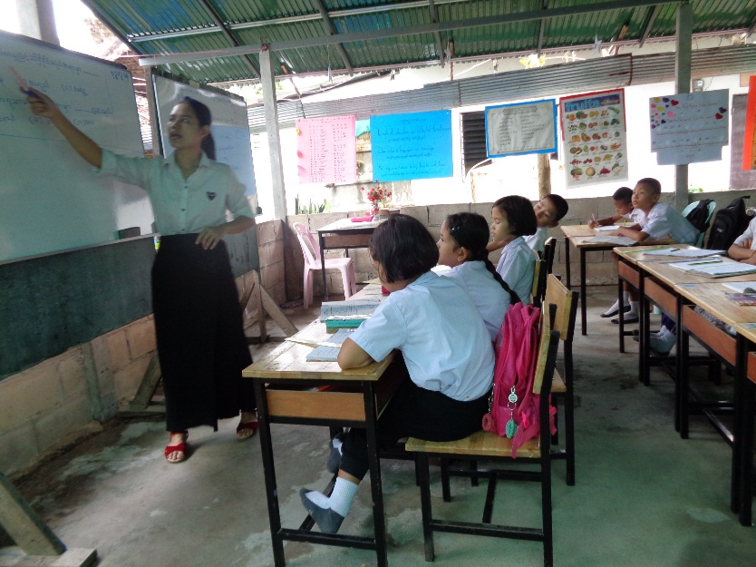
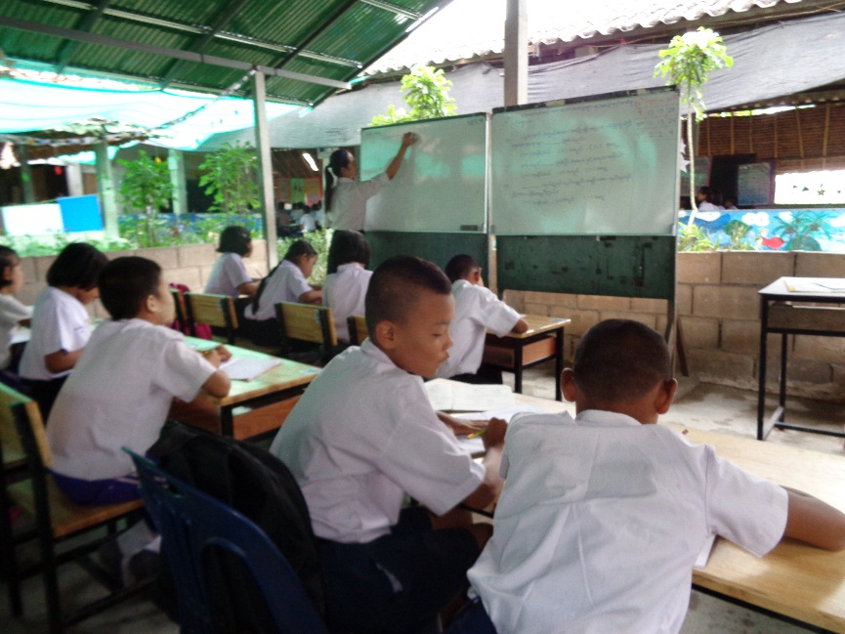
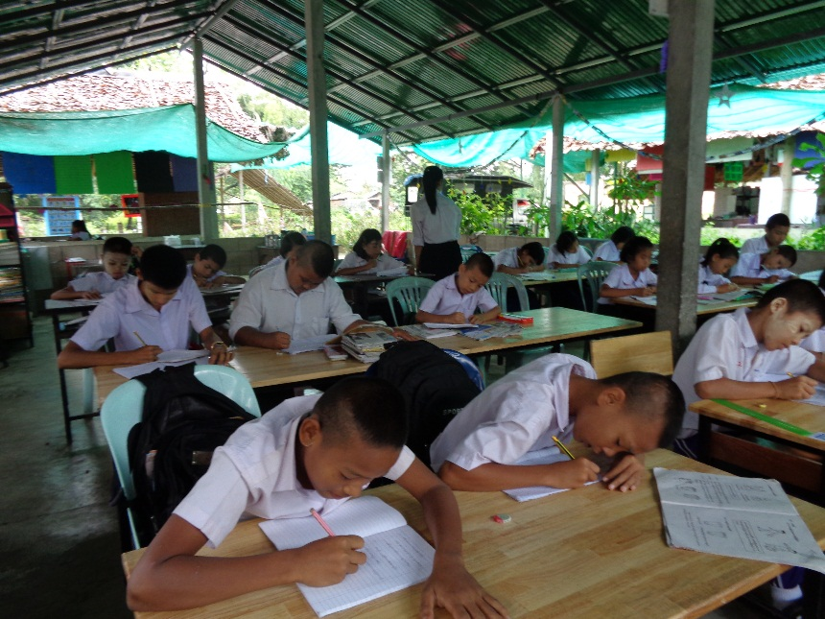
At the beginning – traditional classroom teaching
Rosy teaches science to a Grade three class about “Heat”
She writes questions and answers on the white board.
Afterwards, students copy the answers from the board.
There are no teaching activities in the class.
Children copy and memorise the information.
The class is quiet and well-behaved. The children do as they are told.
Rosy tries to explain “what is movement?”
The students listen carefully and copy into their books.

Slide 4
Feedback – how to move forward
Strong Points
Moving around the classroom.
Having eye-contact and loud voice
Has self confidence.
Areas to develop
Needs to apply child-centered teaching.
Needs to use activities or games to engage more students in the lesson.
Lack of time management and classroom management skills.
Challenges
She has had no teacher training and relies on her own experience of school as a pupil.
She is teaching large classes.
School is in danger of closing and so motivation is low.
It is hard for her to engage all the students.

Slide 5
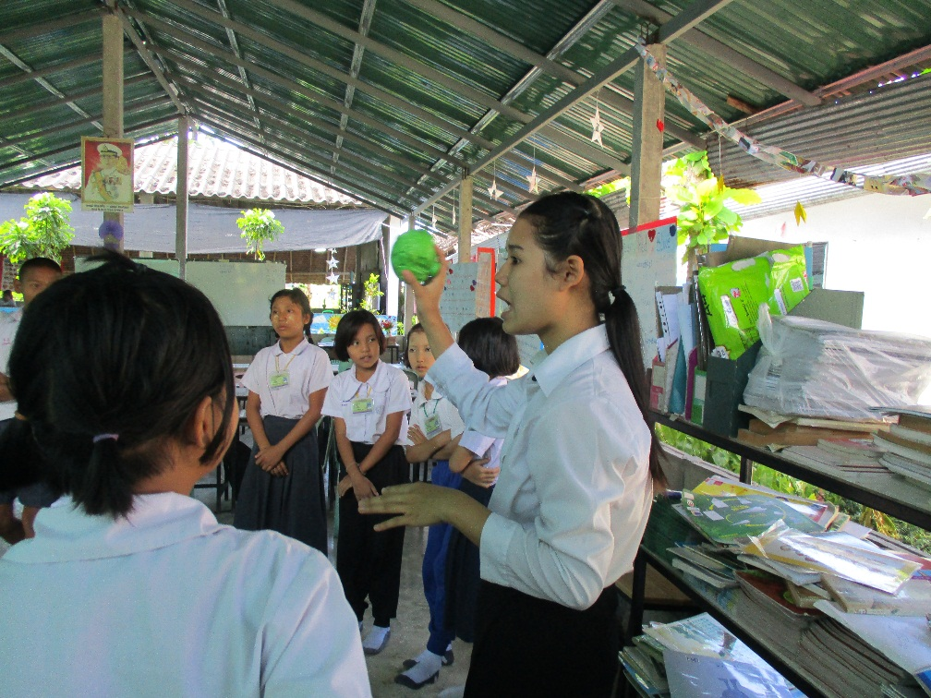
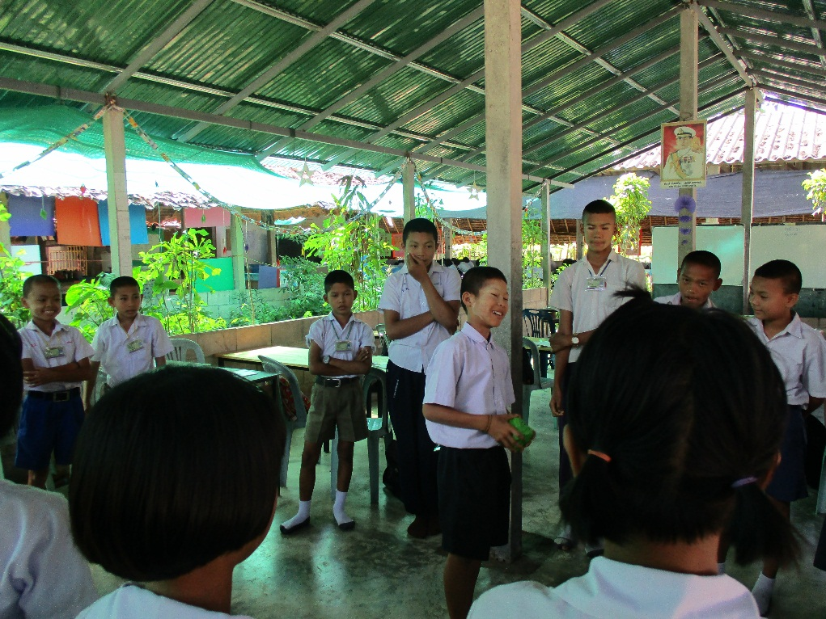
Introducing activities into the classroom
Teaching ‘Movement’
These pictures illustrate some immediate differences. She uses games and activities from the workshop, asking students to make a circle and pass the ball around. When she says stop, students who get the ball have to call out one type of “Movement”
Students are engaged in the activities. Actually, everyone is encouraged to think for themselves. They are ready to speak up with one of the types of “Movement” before it’s their turn.

Slide 6
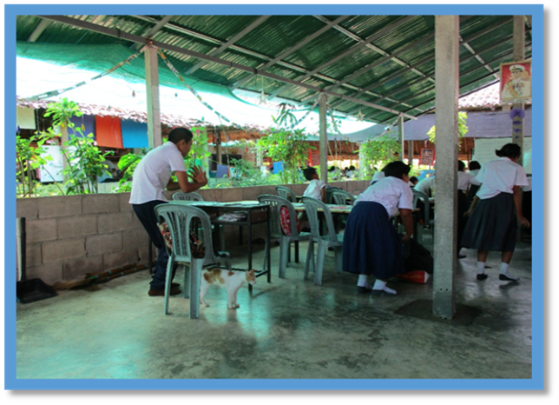
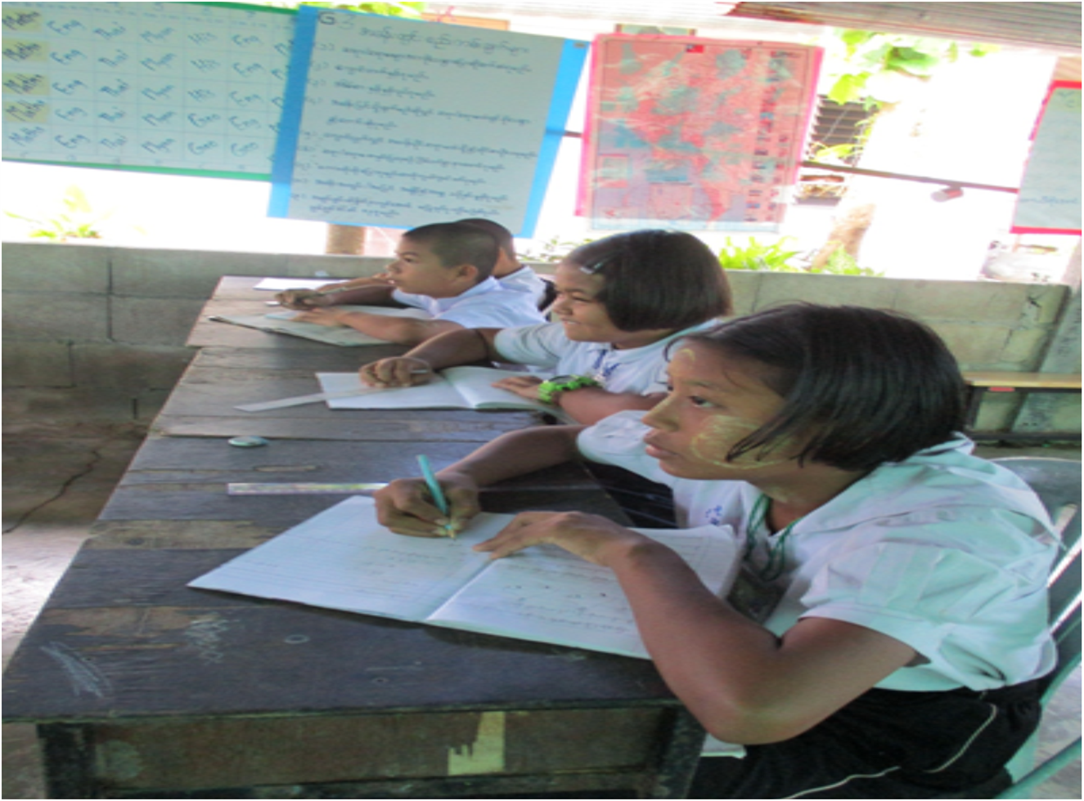
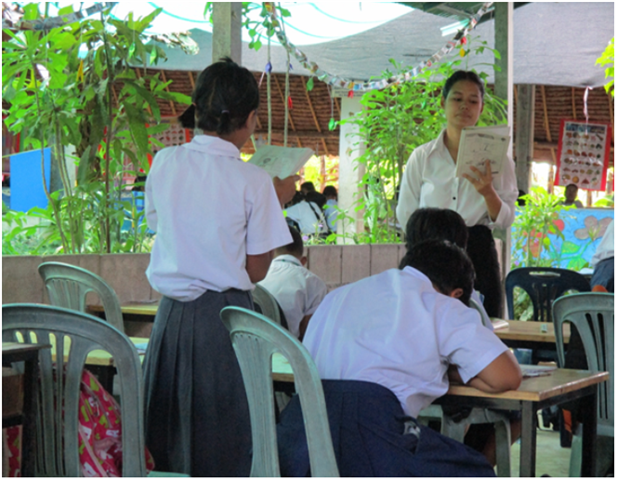
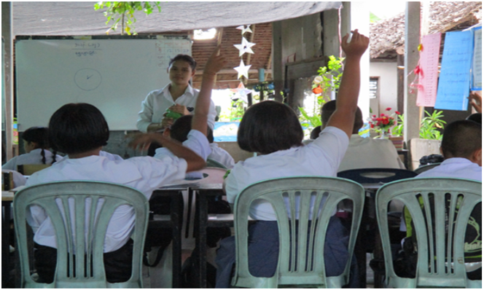
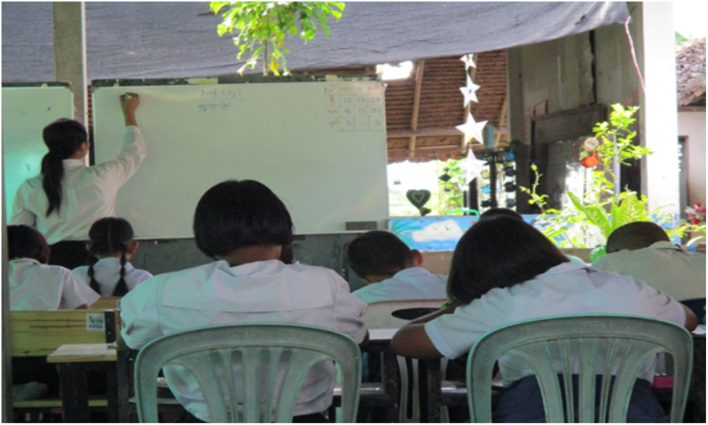
First steps towards the Circle of Teaching
1.
5.
Practice
3.
Checking
Students are doing the actions of Movement
Now, all the students can complete
the task with understanding
Teacher takes the children’s answers and
writes down correct answers on the board
4.
Teacher is asking who know the answers
2.
Checking
Checking answers
Teacher ask her to read out the answers

Slide 7
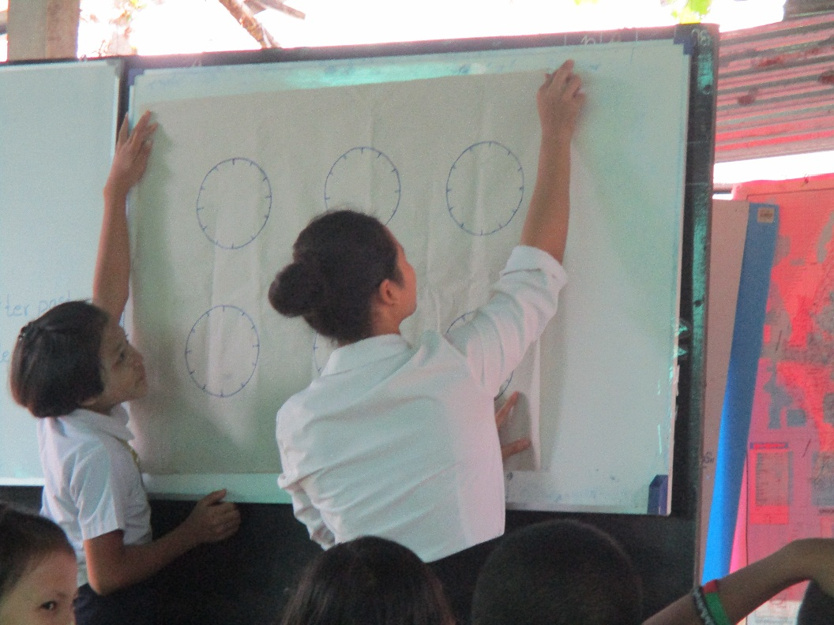
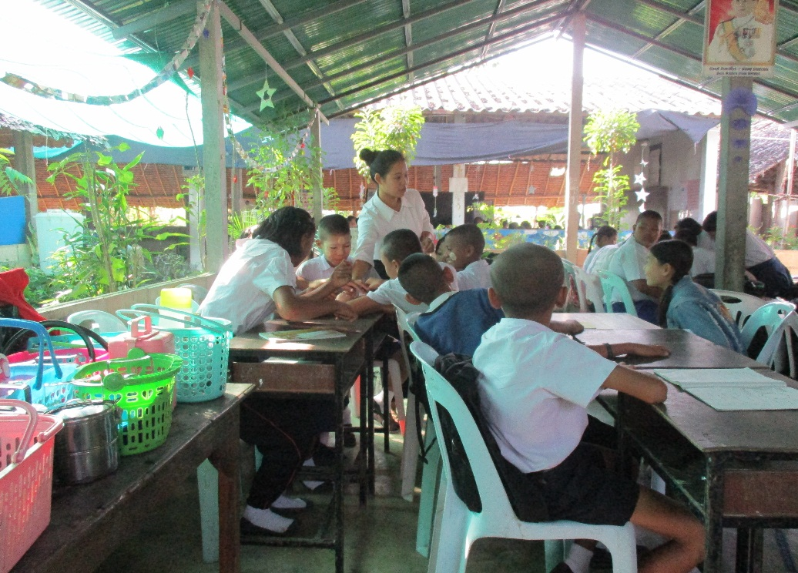
Encouraging the use of teaching aids
Secondly, she divides the class into four groups.
She gives them clock faces, asking them to work together to complete the times.
She gives clear instructions and the children have to work out the answers themselves.
Teaching about ‘time’ – stage 1
She uses flip charts as a teaching aid to explain carefully how to read the clock and she explains it step by step.

Slide 8
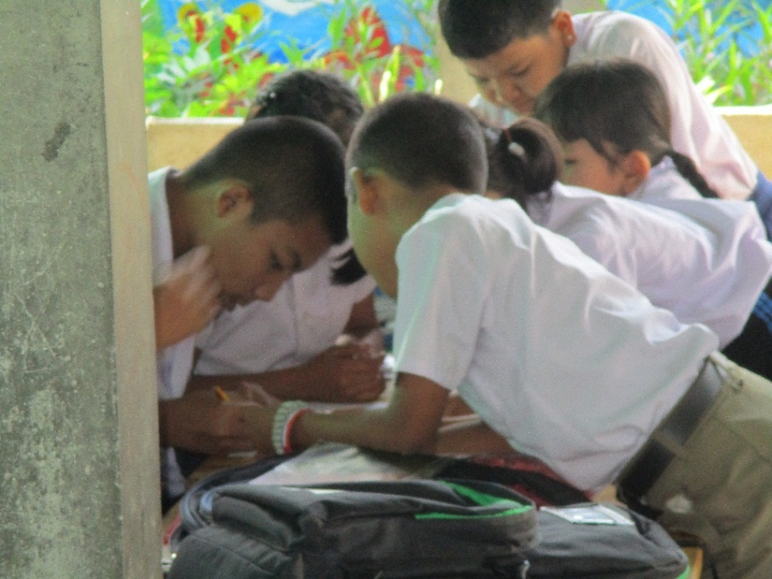
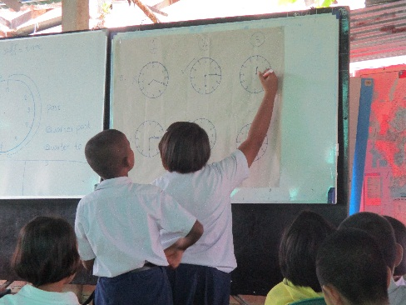
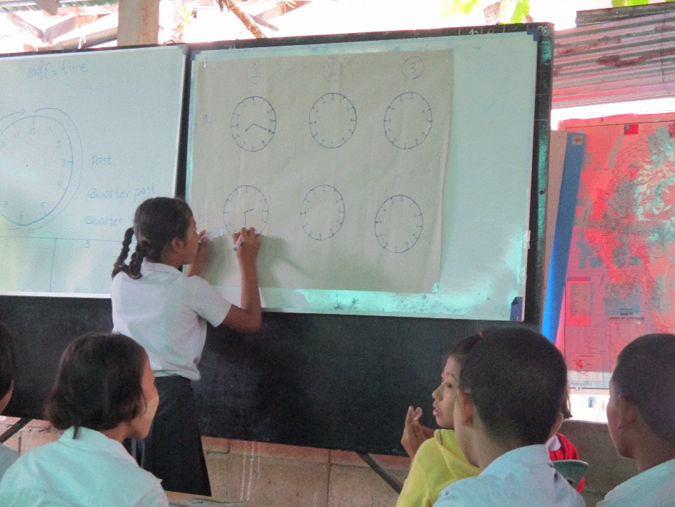
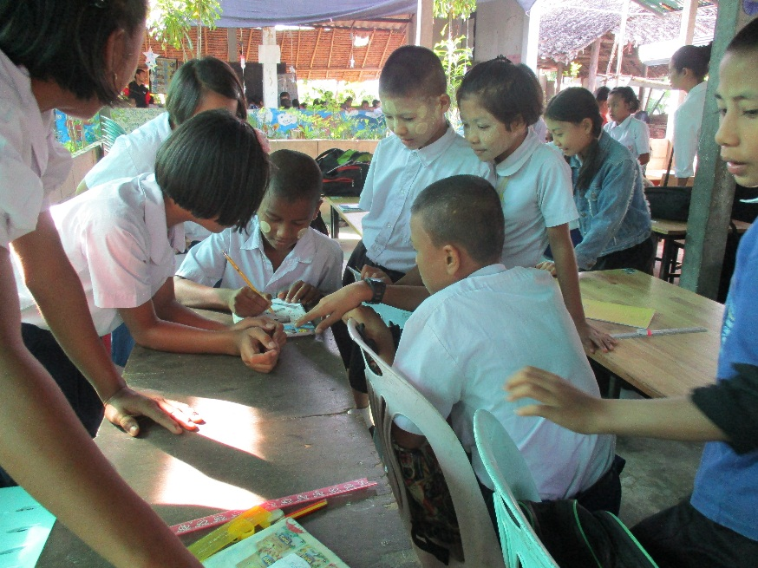
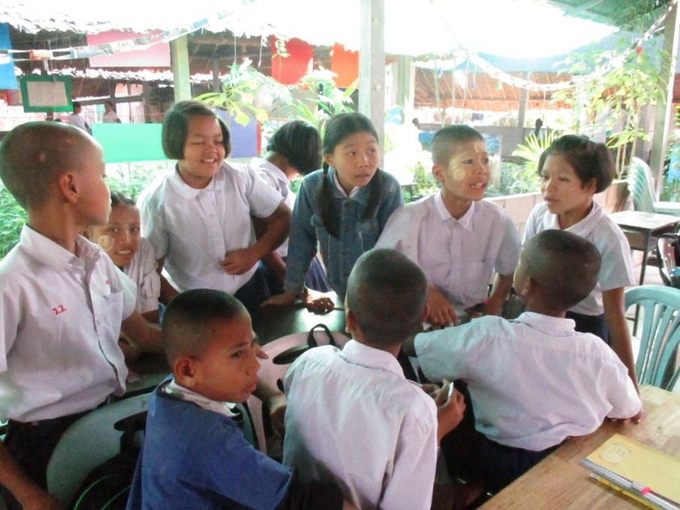
Introducing group discussion
All the students can participate to complete the task on their clock faces.
The group discussion motivates them to think for themselves. They cooperate, learn from each other and have confidence to speak up.
After the discussion, each group comes to the front to complete their times on the flip chart. This way is good for the students to develop more self-confidence.

Slide 9
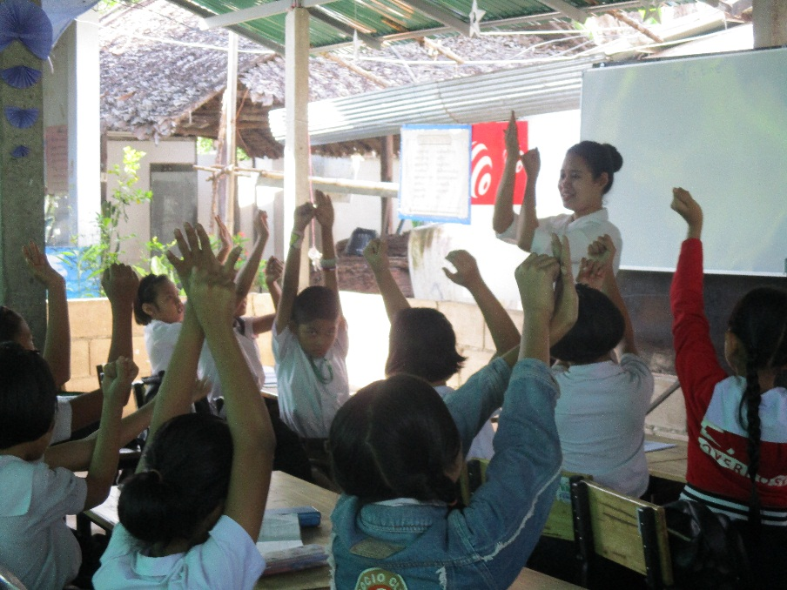
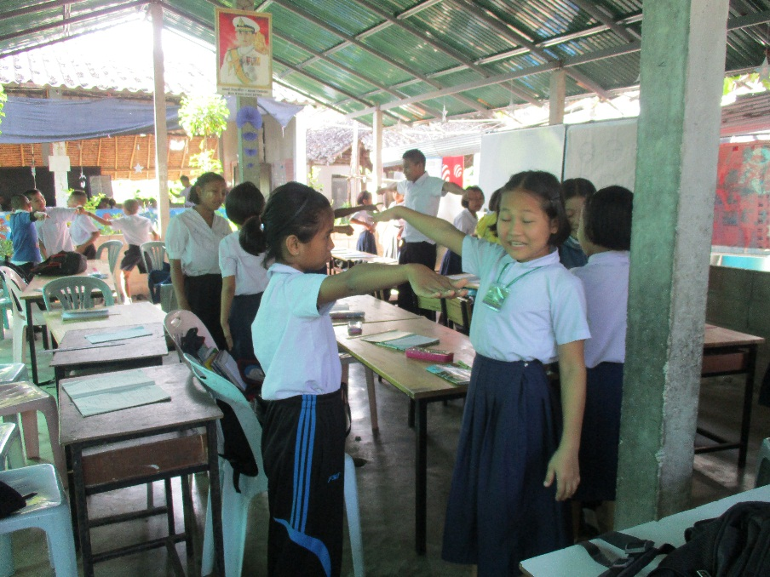
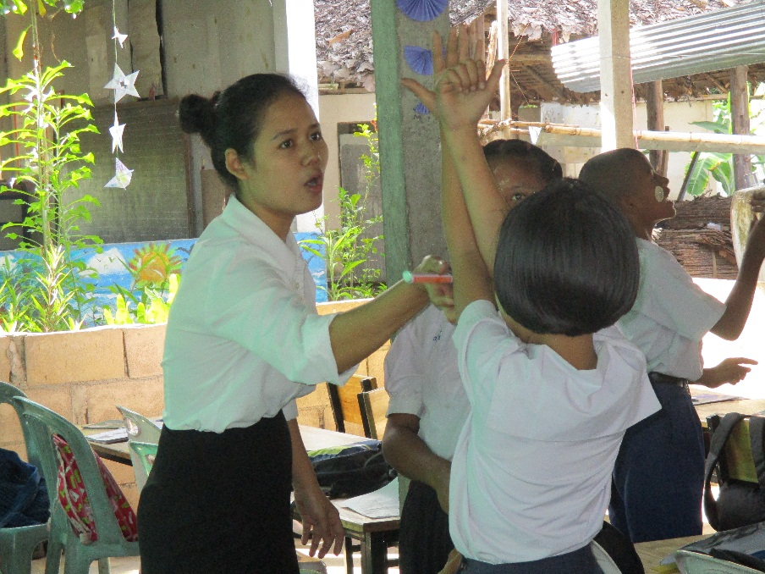
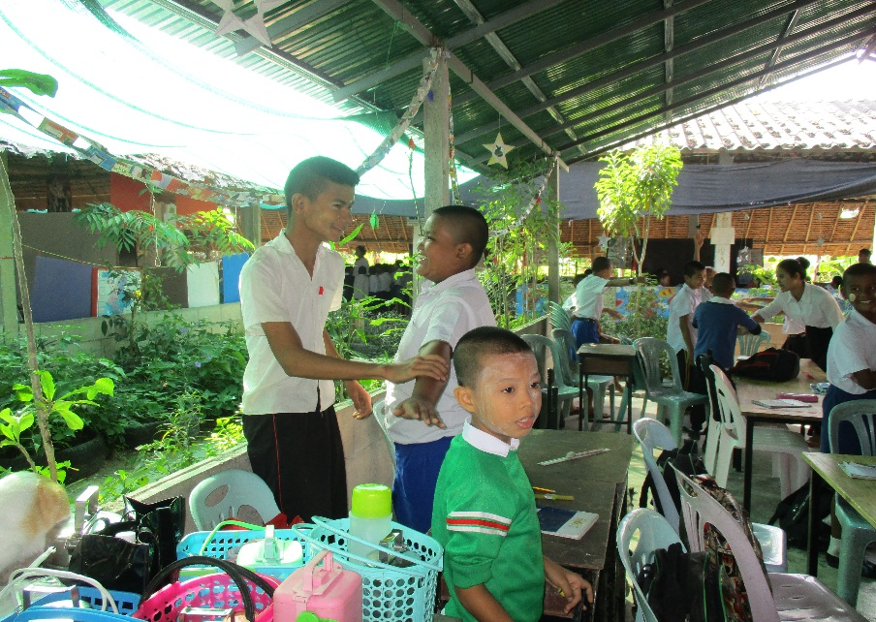
Active and fun ways to practice ‘time’
1
2
3
The teacher is acting as a clock and shows the time, then students guess the time.
Afterwards, teacher ask them to pair up. One is a clock and one tells the time. All the students can participate in the activities and have a chance to speak up.
4
3. Teacher looks up and goes around the class, then monitors the students.
4. All the students are enjoying the activities, it seems that they are happy and learning has become fun.

Slide 10
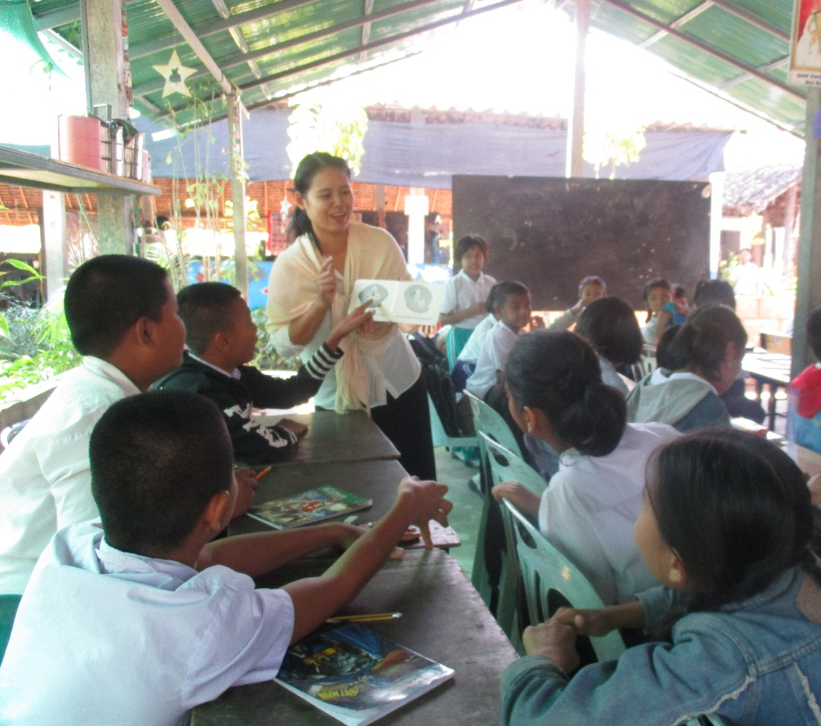
Building relationships and engaging children
Before she starts her teaching, she builds relationship with the students by telling them a story.
Building a strong relationship is really important for the teacher to build trusting and easy communication between each other.
Teacher goes around the class and shows the pictures of the story. It seems the students are really interested in the story.

Slide 11
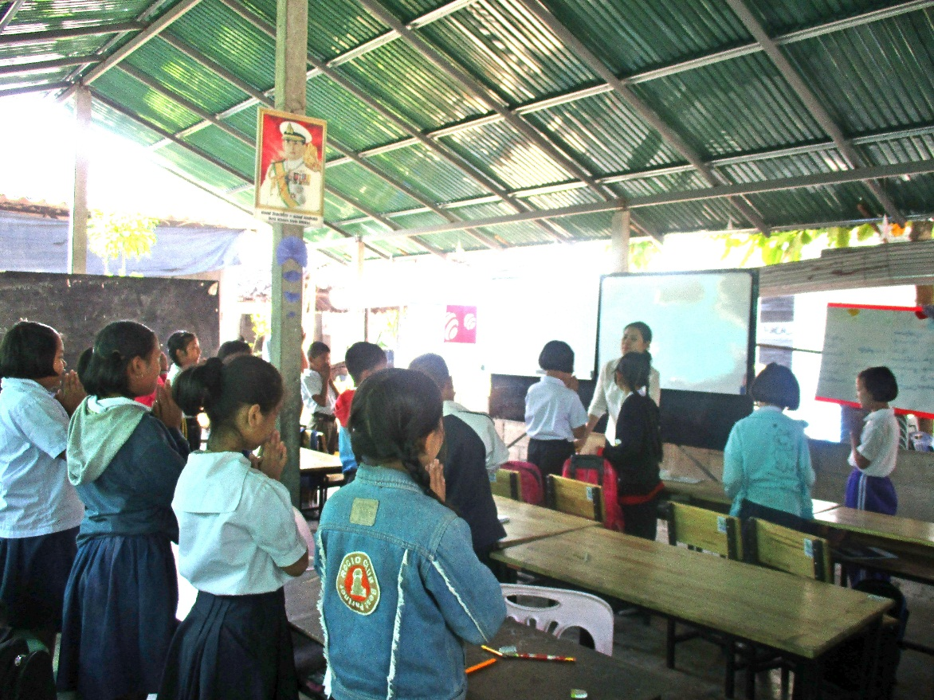
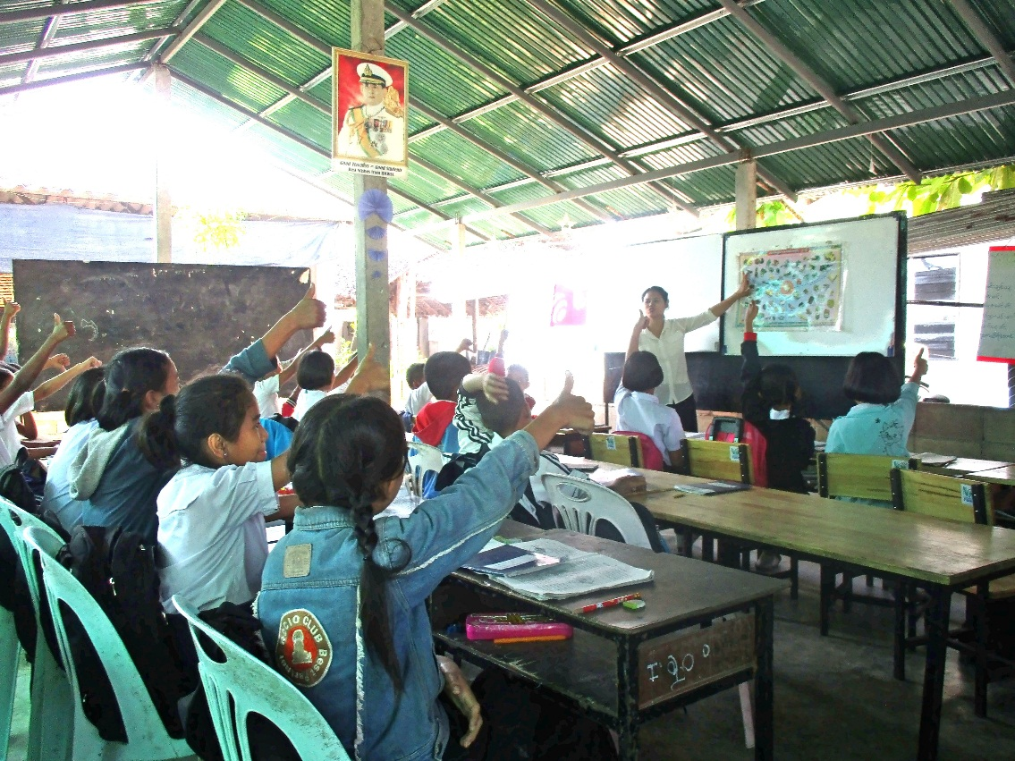
Encouraging lessons to be well planned
Grade-III
(Science)
Stage-2 : Review
She checks what they learnt in the previous lesson about plants. Using ‘thumbs up - thumbs down’ she asks questions and they respond. This is a way to memorize what they learn and to recall their memory.
Stage-1 : Greeting
Rosy greets the students with a smiling face.

Slide 12
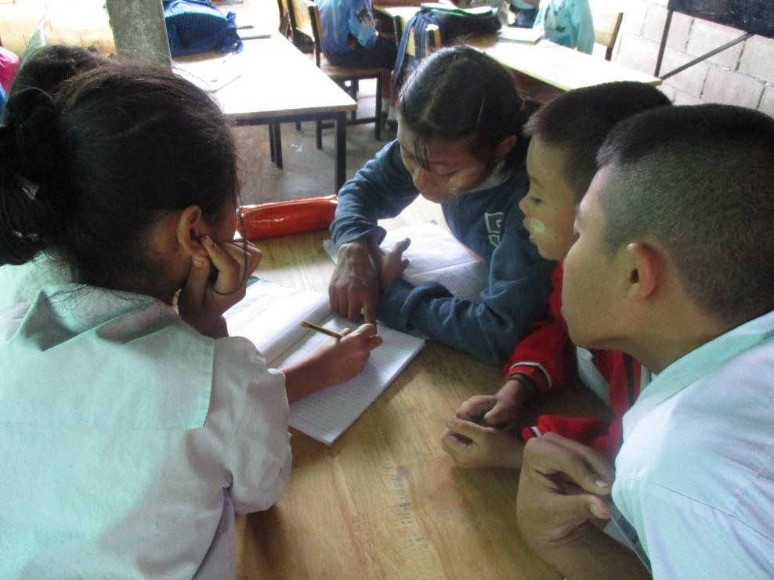
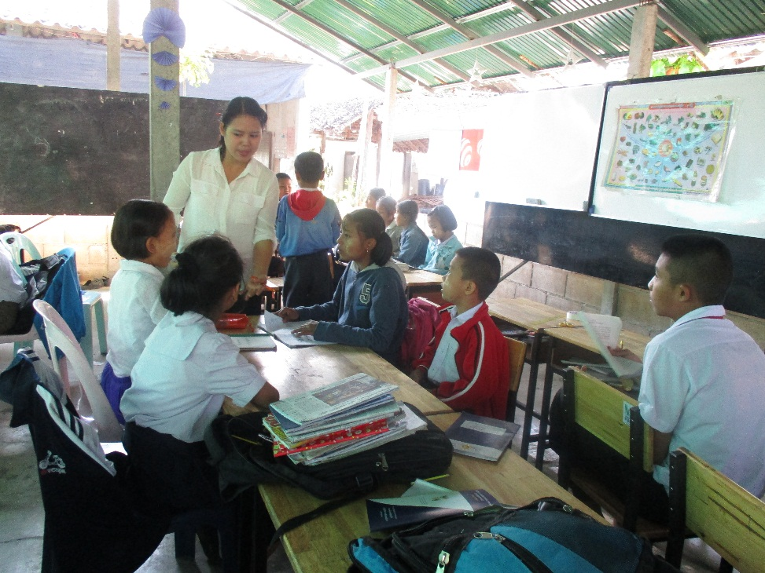
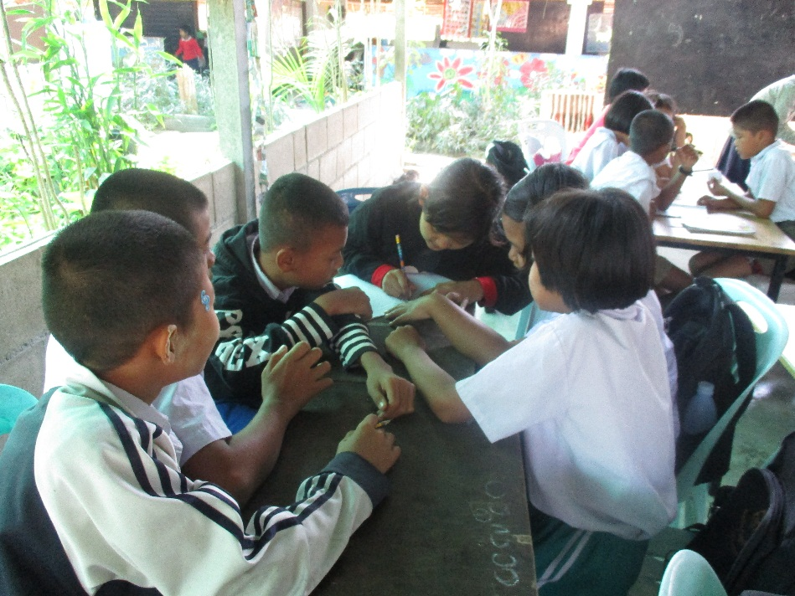
Developing the teaching stages
Stage 3: Previewing – eliciting information through group work
Each group are given different questions to list down on their paper sheet.
Rosy monitors each group.
This is a good way to elicit the information from the students what do they know about vegetables.
Rosy divides the students into small groups and ask them to list down sustainable vegetables, unsustainable vegetables, and which ones are good for health or not good for health.

Slide 13
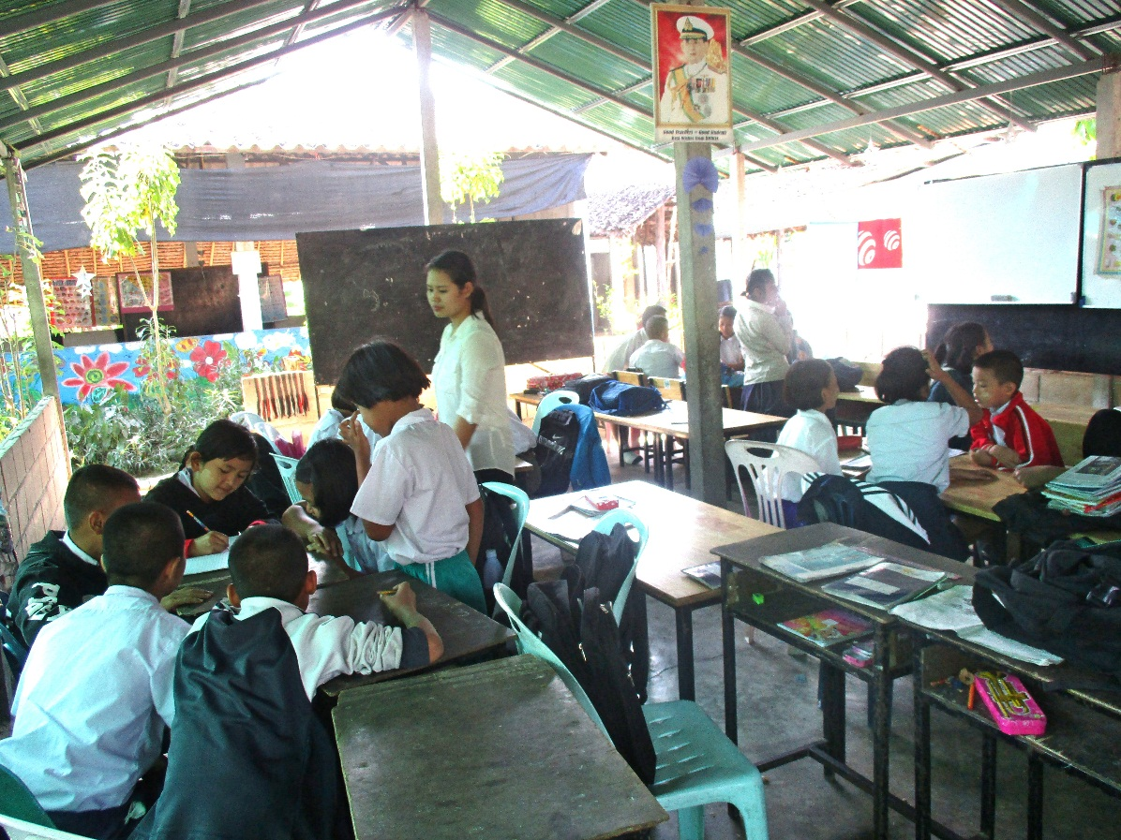
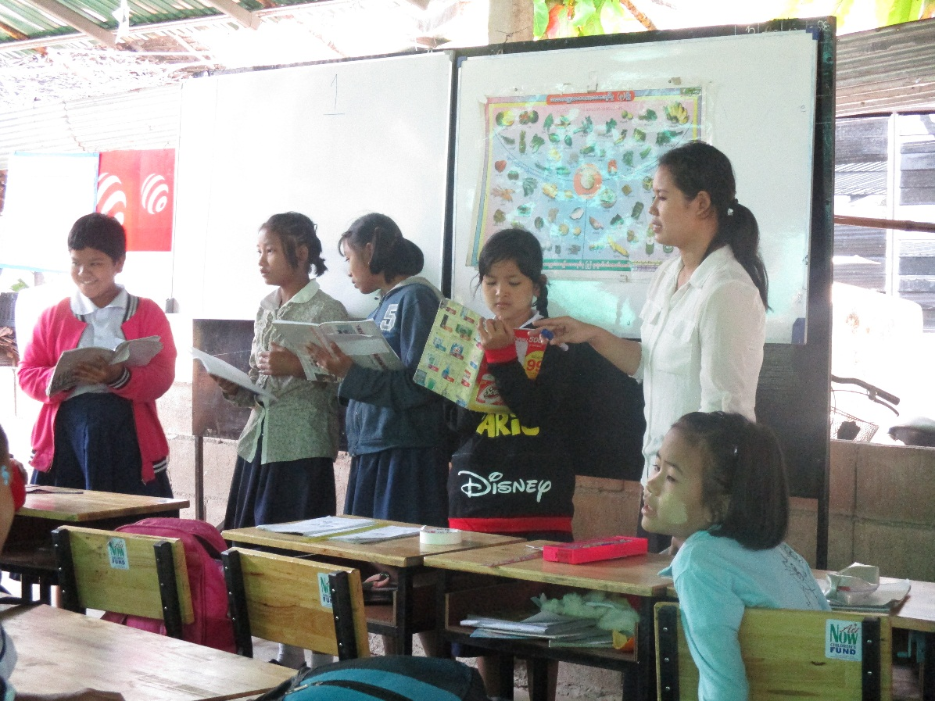
Developing the teaching stages
Stage-4 : Practising and preparing answers
Teacher asks each group to be ready and present their answers. She gives time to check the vegetable’s name again and why they chose them.
Then they choose one representative from the group members to present.
Now is the presentation time.
All the representative seem that they have self confidence.
They have had time to talk and prepare.

Slide 14
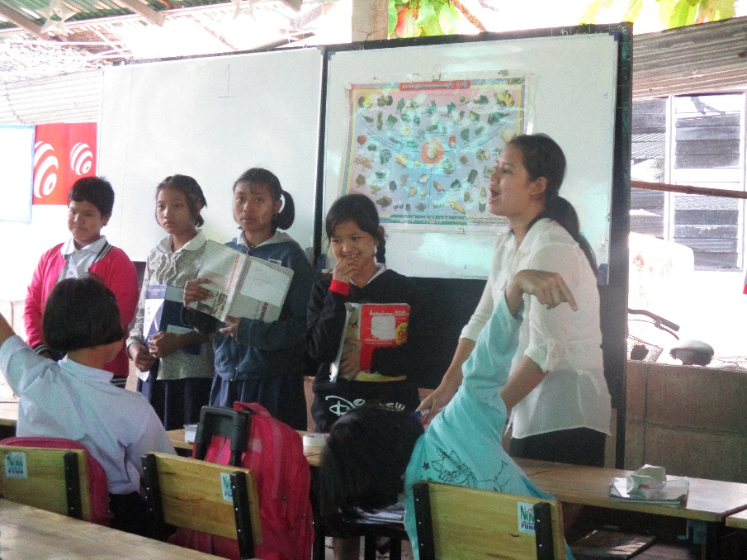
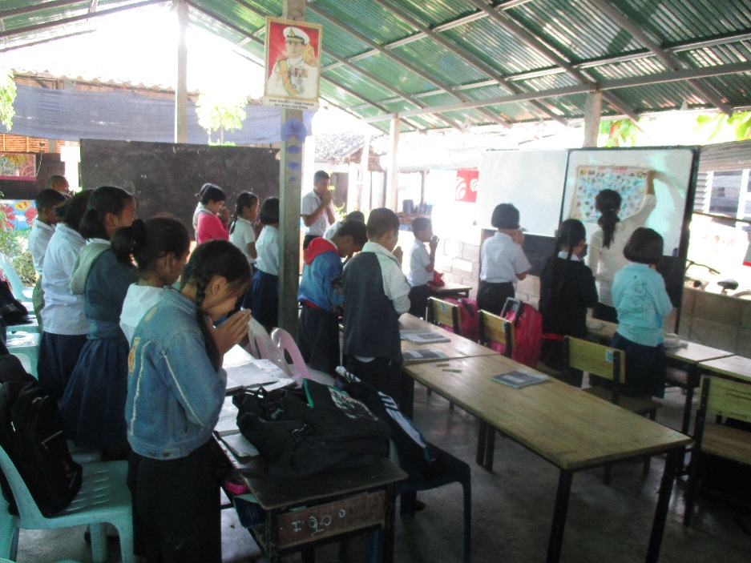
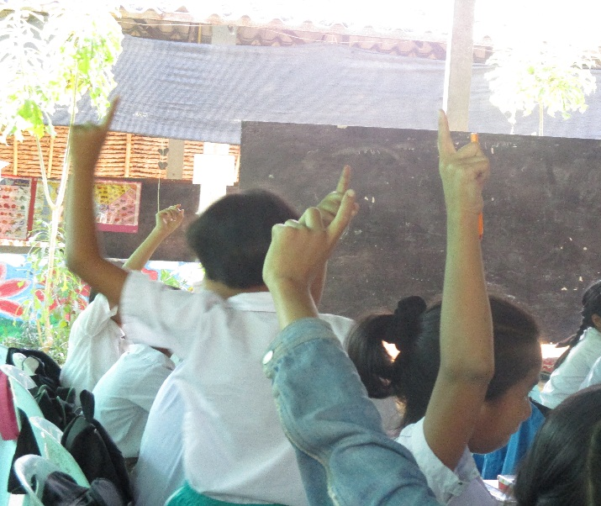
Developing the teaching stages
Stage-5 : Checking what has been learnt
Stage-6: Good bye
After the group presentation, Rosy asks groups to check which groups are listed.
Can they say if most or all of them are correct or not.
Then, if they liked their group presentation, ask them to raise their hand to support them.
Finally, Rosy gives the students homework to observe some of the vegetables when they go back to home.
Then, she says good bye to the class.

Slide 15
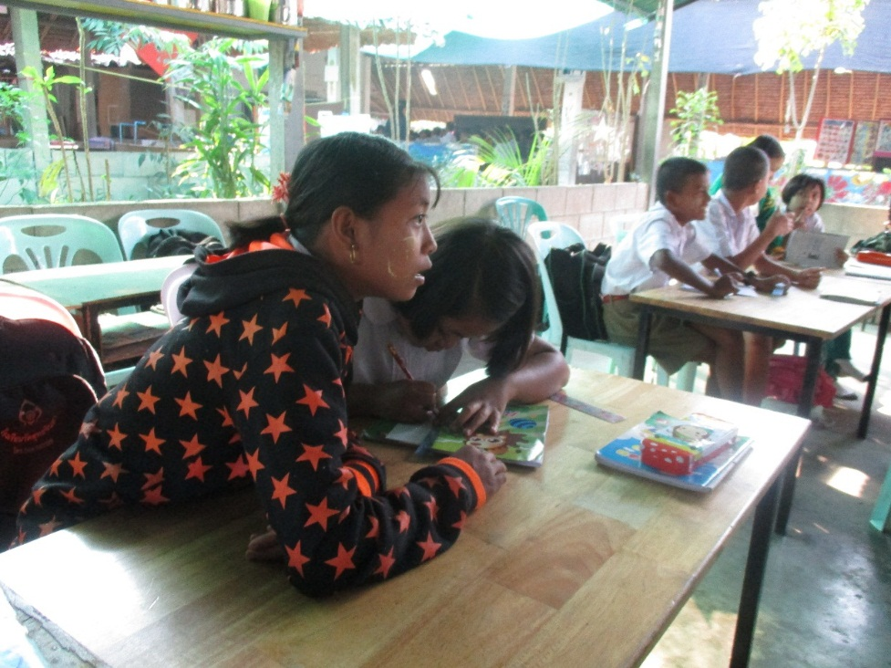
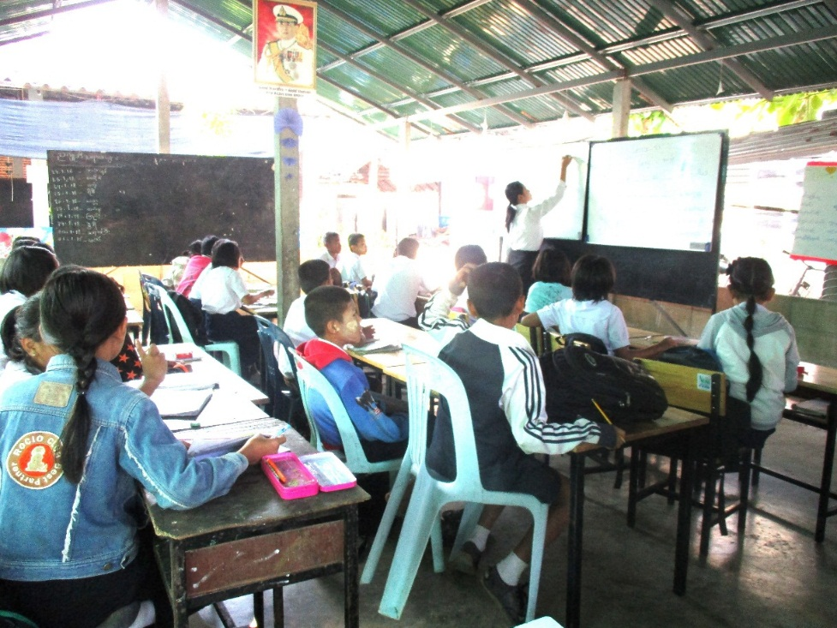
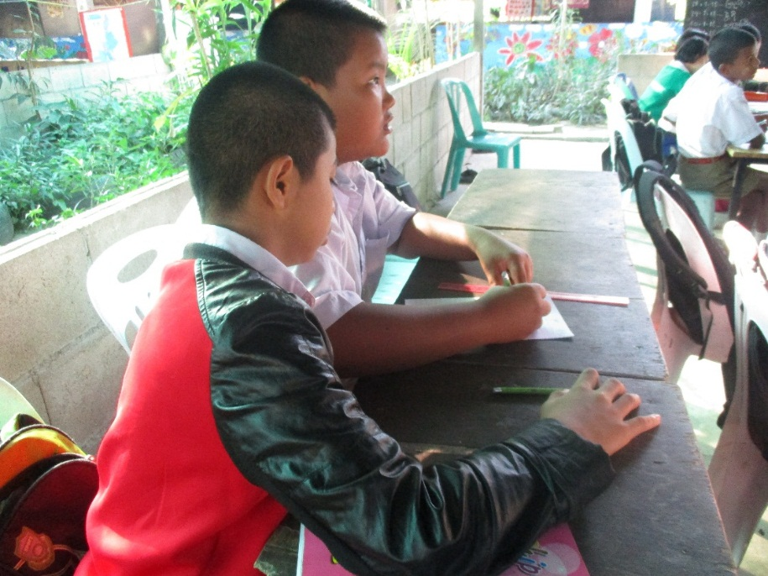
Using formative assessment ….
Rosy is checking vocabulary that she has taught.
This doesn’t have to be done as ‘a test’
Instead Rosy pairs up students to work together to fill in the blanks.
This way motivates them to help and support each other.

Slide 16
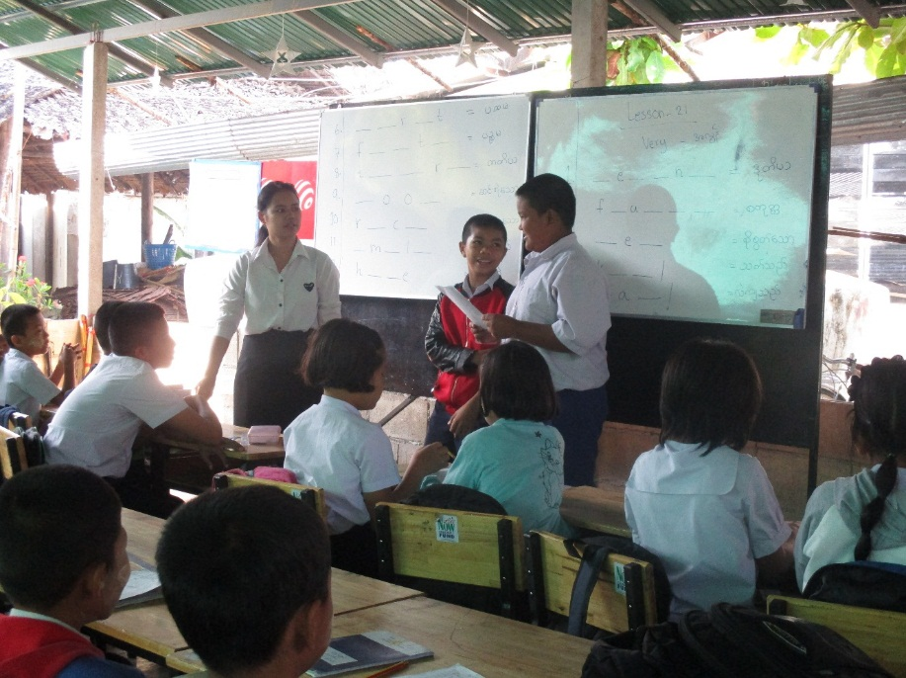
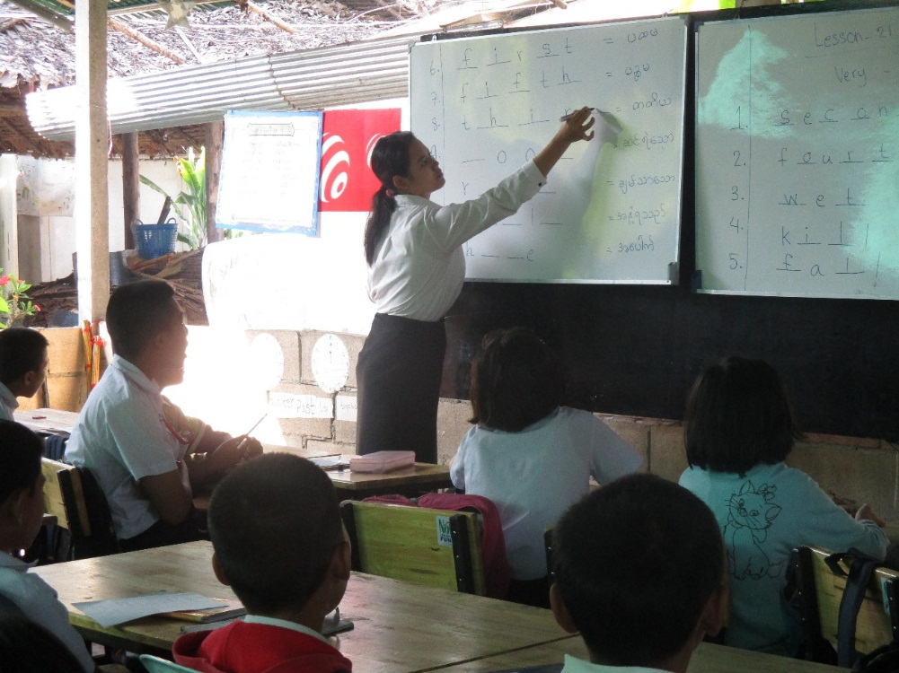
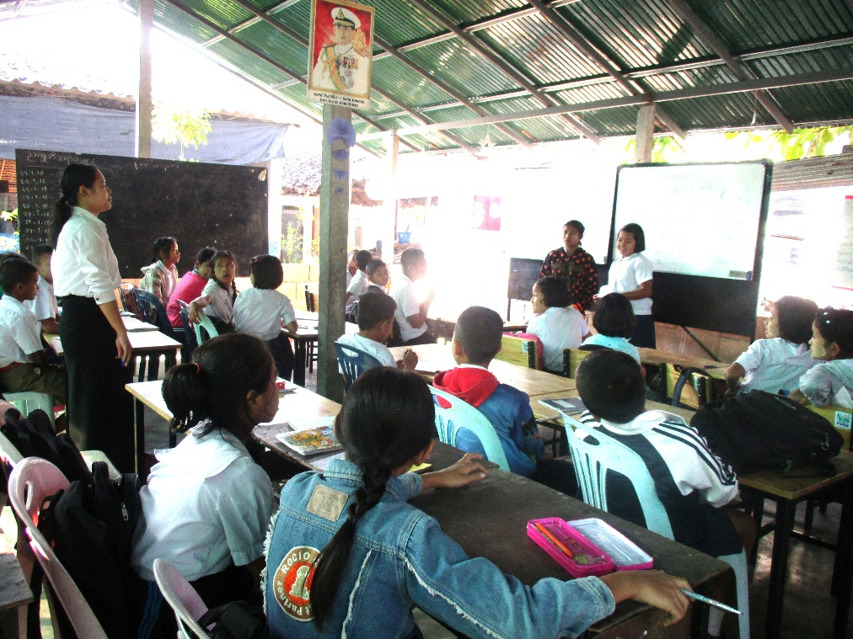
….. and checking what they know.
When the students have filled all the blanks, Rosy asks each pairs to read out their answers in front of their friends.
She asks the whole class to check the answers whether right or wrong.
Afterwards, Rosy gives the right answers on the board.
This is revision for exams and gives the students more practice in the class. Actually, Rosy now knows more about the students situation, how much they memorized from the precious lesson.

Slide 17
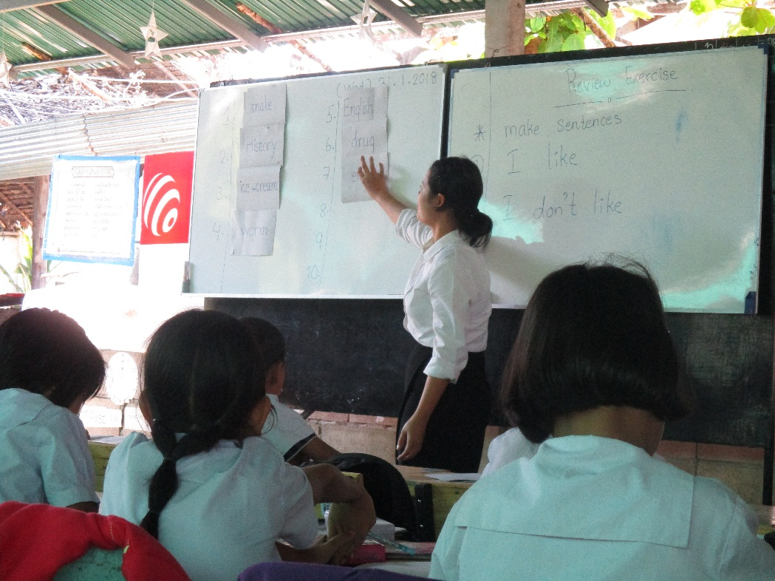
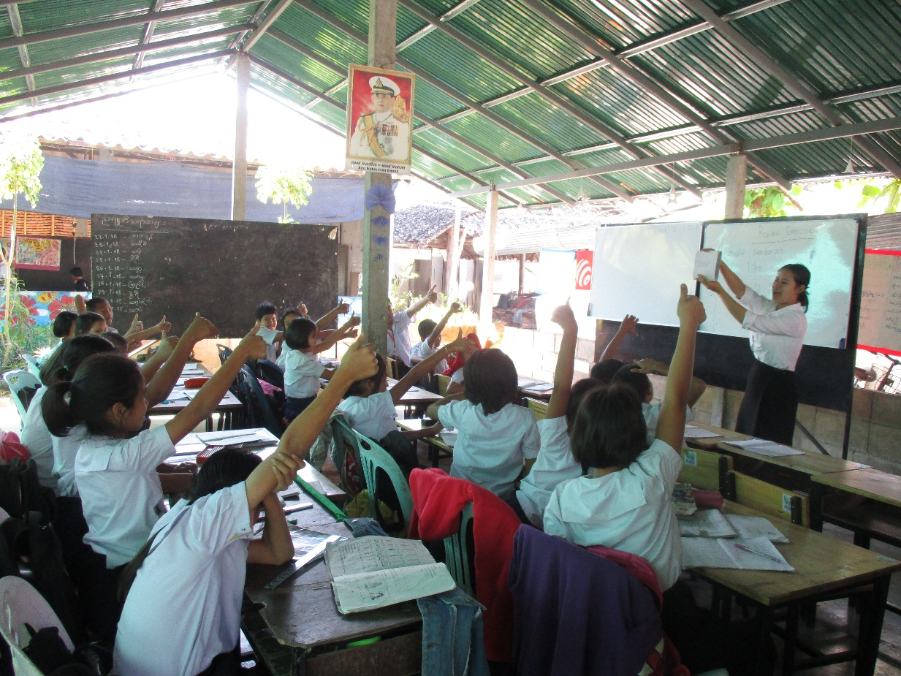
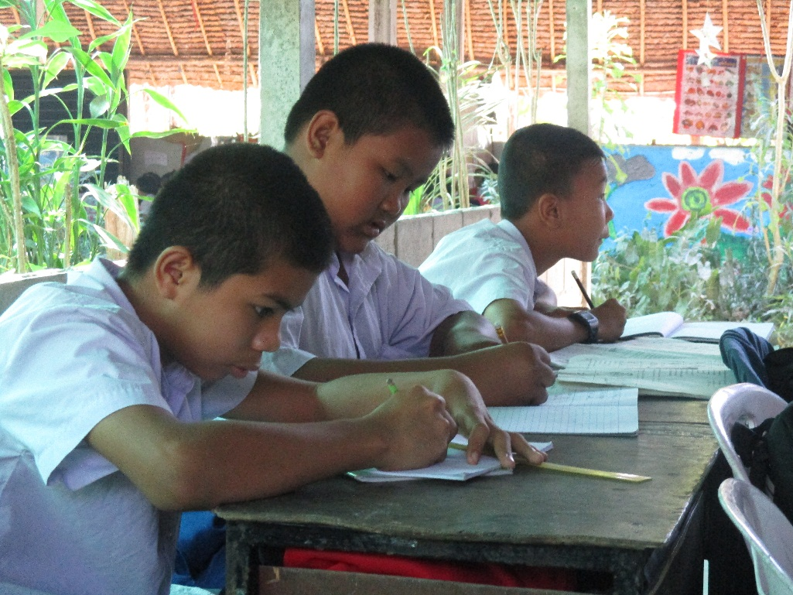
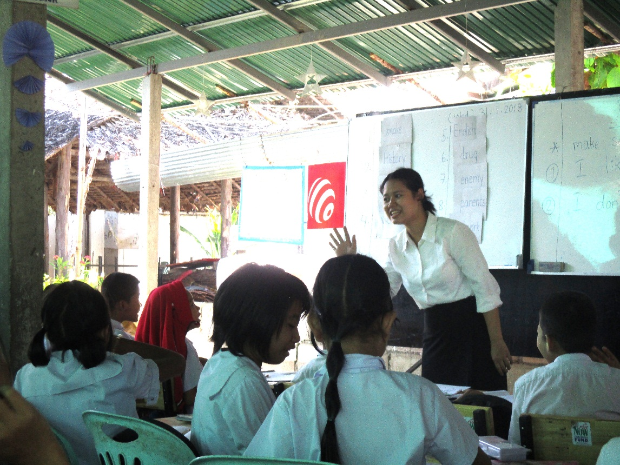
Introducing different methodologies
Using word cards:
2
3
1
Rosy puts the words one by one on the white board and asks students to repeat all the words.
Checking what they know
and introducing the new words
Then, Rosy asks all the students to write down all the words after repeating them.
4
Rosy shows an action for each word from which the students try to guess the words.

Slide 18
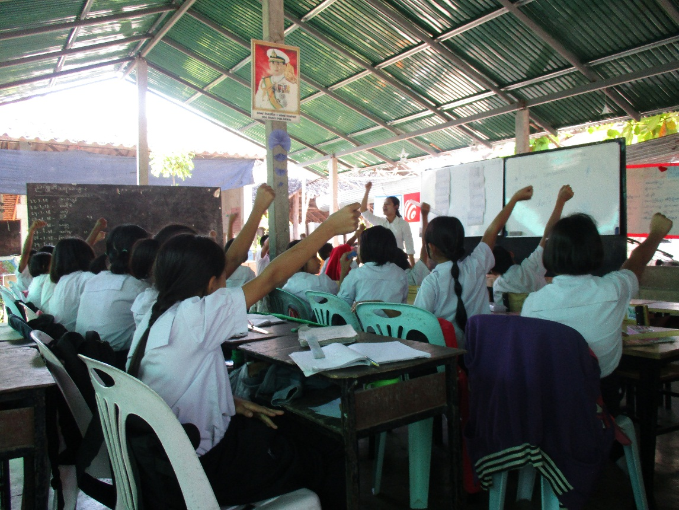
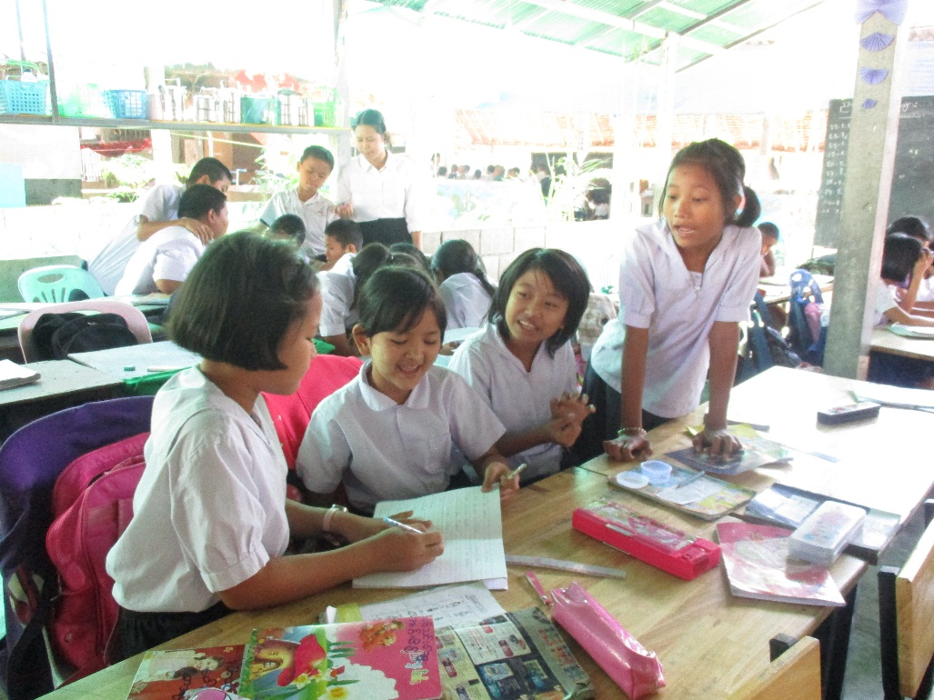
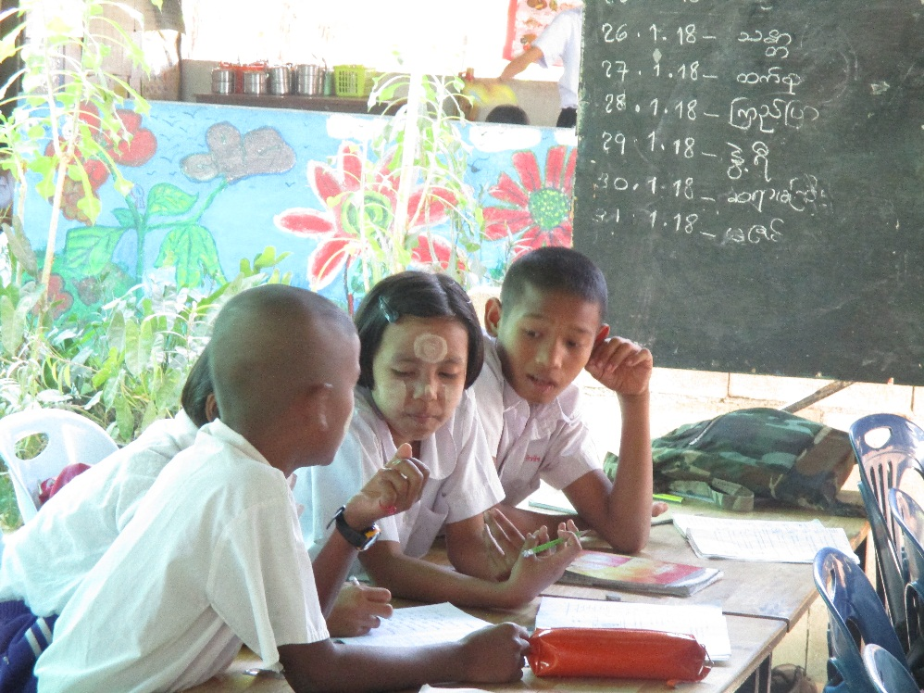
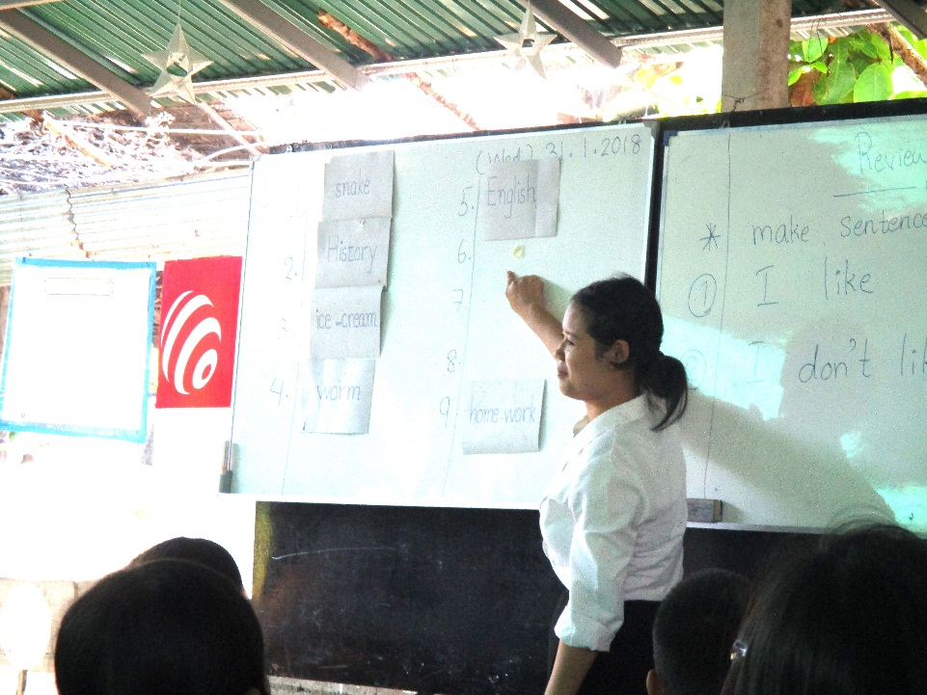
Introducing different methodologies
Using word cards:
5
The children have fun practicing the actions for the words. The begin to recognise the words easily
Rosy removes words one by one and asks them to repeat the words. How many words can they remember as she removes them. She repeats the words over and over
7
Then, she divides them into small groups and asks them to write down the words they can remember.
The students have no fear for the informal assessment test because they have to discuss together.
6

Slide 19
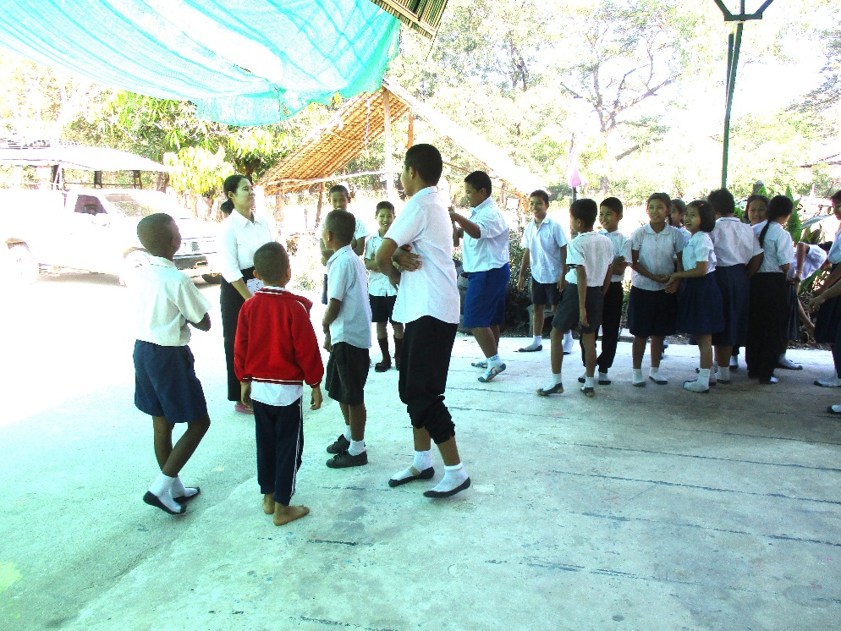
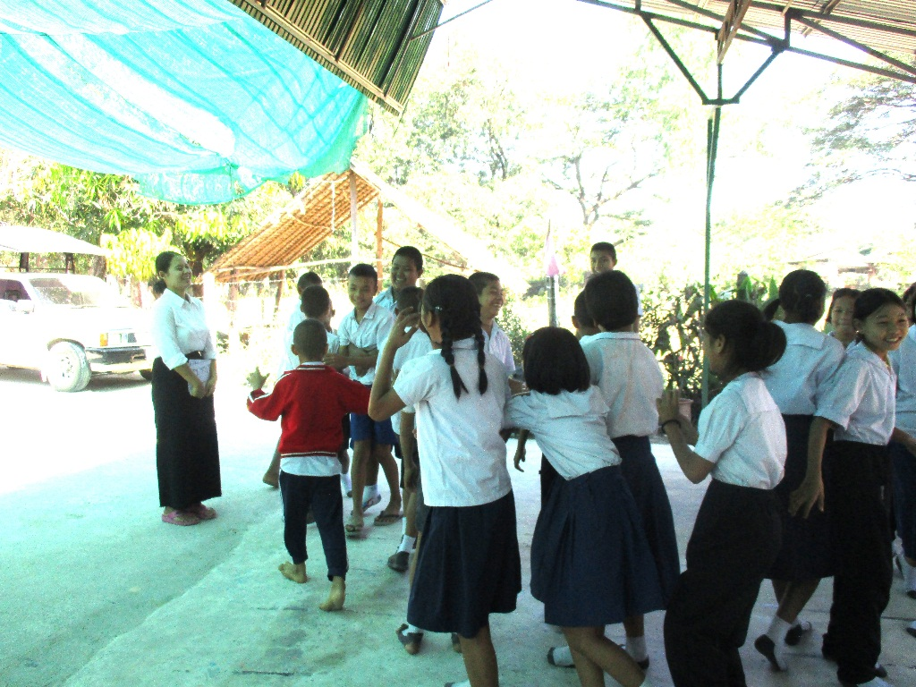
Introducing new methodologies: Checking by questioning
Rosy uses an outdoor activity for checking.
She asks questions about the vocabulary to find out how the students respond (eg: Who loves their parents? Who likes the enemy?)
Rosy lines the children up in two lines. One line is ‘like’ and one is ‘dislike’.
This activities are good for the teacher to know more about student’s situations and feelings.
There are three students who do not like their parents – Rosy knows they have not understood the word.

Slide 20
Final Outcomes
Methodologies:
Rosy is now using variety of methodologies which includes pairs’ work, groups’ work, and individuals work and she is focused on child-centered methods.. All the students are engaged and there is active learning . She uses visual aids which includes flashcards, wordcards, flip chart, and picture book effectively.
Classroom Management:
She prepares lesson plans for her teaching and she can accomplish lesson objectives. She is very strong in classroom management, and supports her students by creating a positive classroom environment.
She does her best in the teaching. Yes, she is a good teacher for the students.

Slide 21
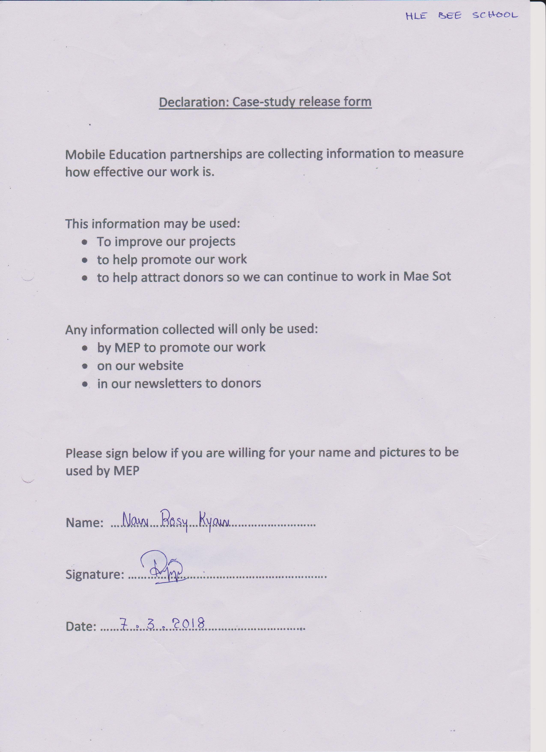
Disclosure Form for Naw Rosy Kyaw

